Slide 1
Gender Voice Recognition
ML-2 Project
Submitted by: S Sriram

Slide 2
Objective
Predict the pattern of voice whether male or female.
Use best classification algorithm for prediction.

Slide 3
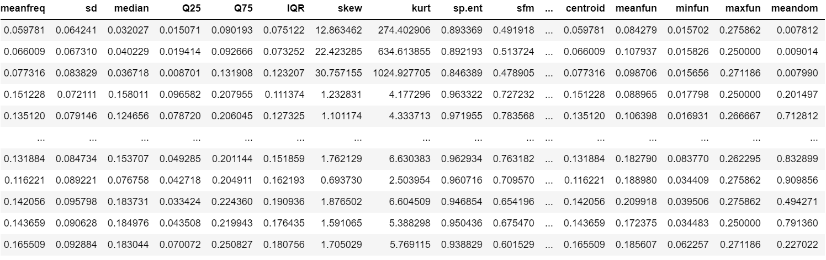
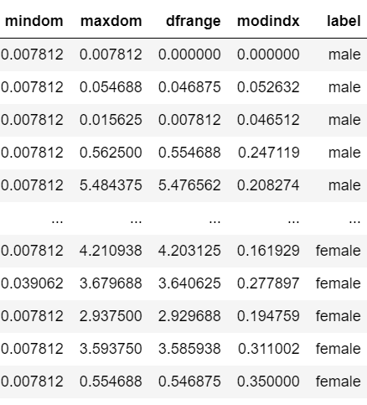
Sample Data …

Slide 4
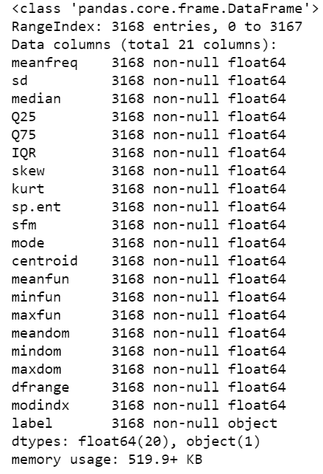

Let us perform EDA …
1. Does the dataset have missing values?
There are no missing values in the dataset.

Slide 5
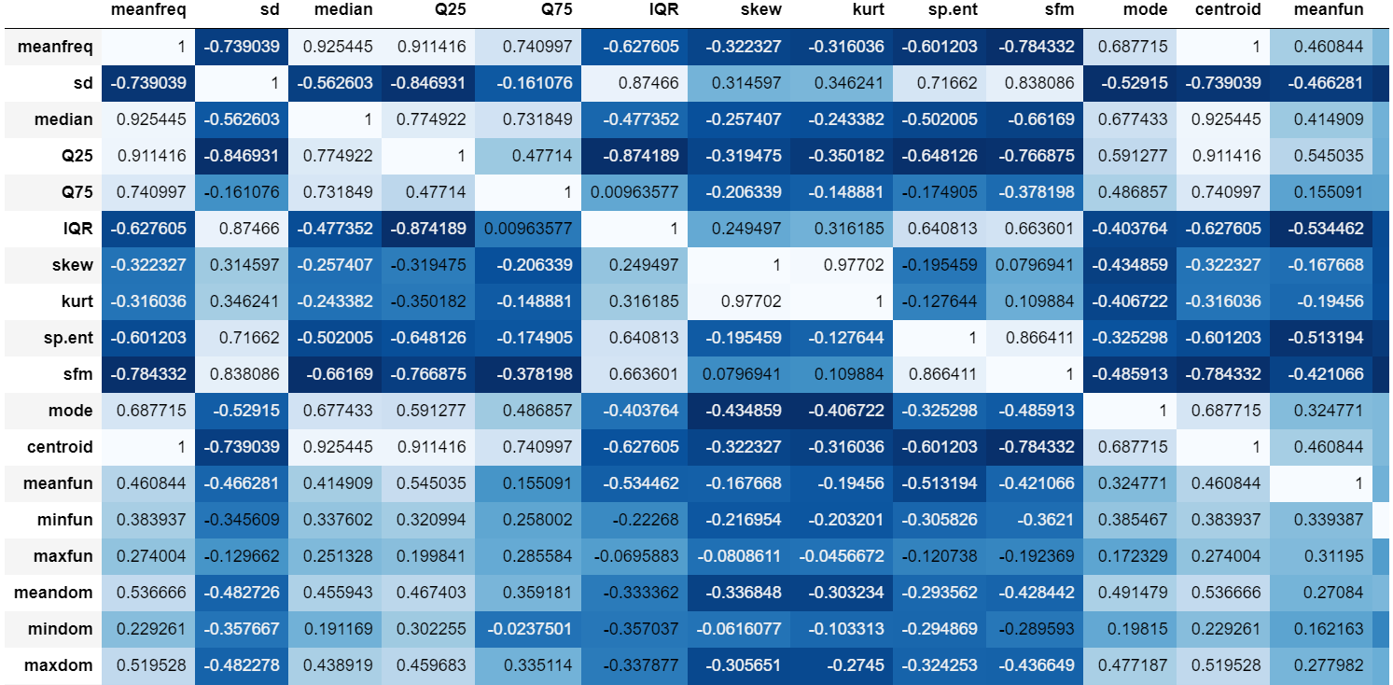
Let us perform EDA …
2. Is there correlation in data?

Slide 6
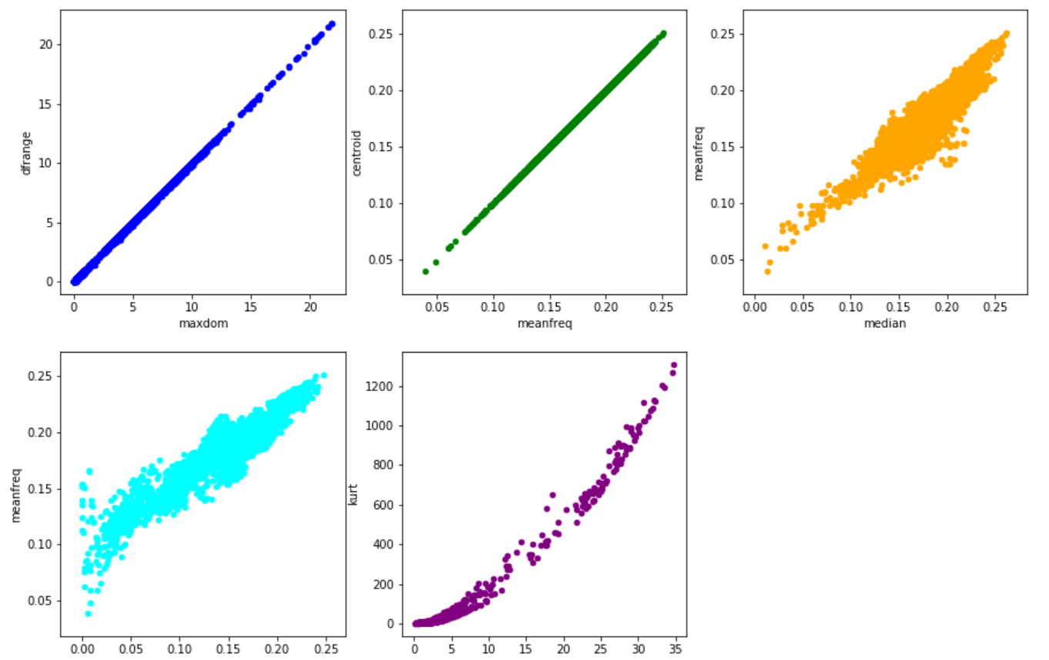
Let us perform EDA …
2. Is there correlation in data?

Slide 7
Let us perform EDA …
Observations on Correlation
**Observation:** As we could see from the above scatter plots, there is a high correlation among the below variables:
1. dfrange and maxdom
2. centroid and meanfreq
3. meanfreq and median
4. meanfreq and Q25
5. kurt and skew
Hence let us remove the columns maxdom, meanfreq, median, Q25 and skew

Slide 8
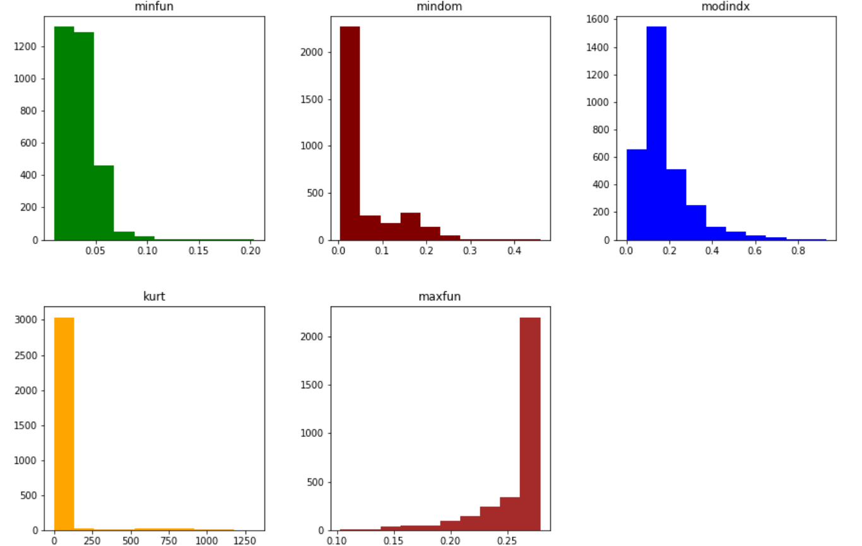
Let us perform EDA …
3. Is the data skewed?

Slide 9
Let us perform EDA …
3. Is the data skewed?
Observations
Below fields are right skewed:
minfun
Mindom
Modindx
Kurt
Below are left skewed:
maxfun

Slide 10
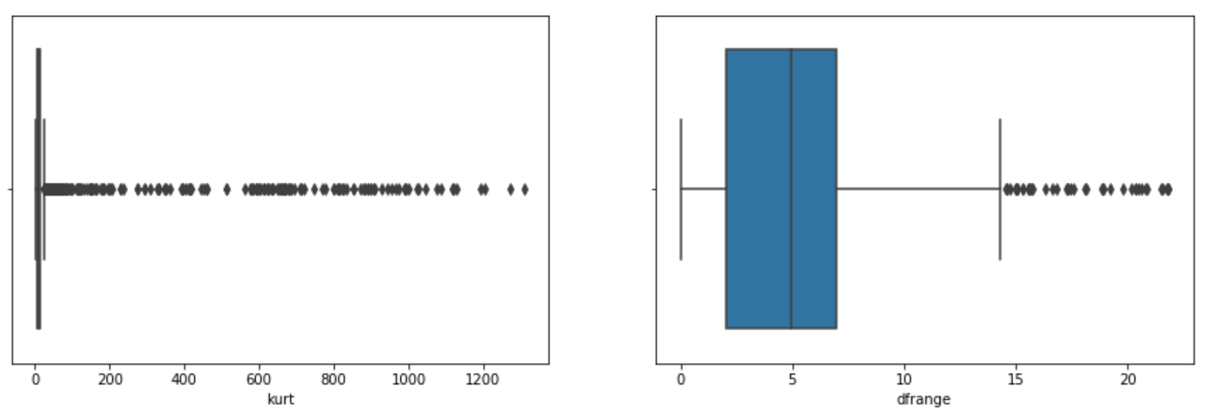
Let us perform EDA …
4. Are there other outliers in data?
Observations:
Outliers are high in "kurt" columns while "dfrange" have moderate outliers

Slide 11
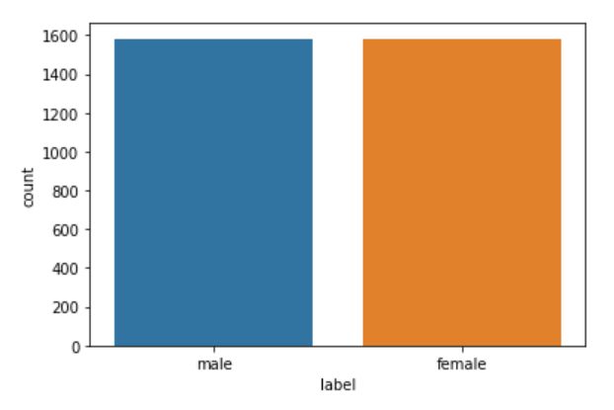
Let us perform EDA …
5. Is the class balanced?
Observations:
The class is well balanced with equal number of male and female classes.

Slide 12
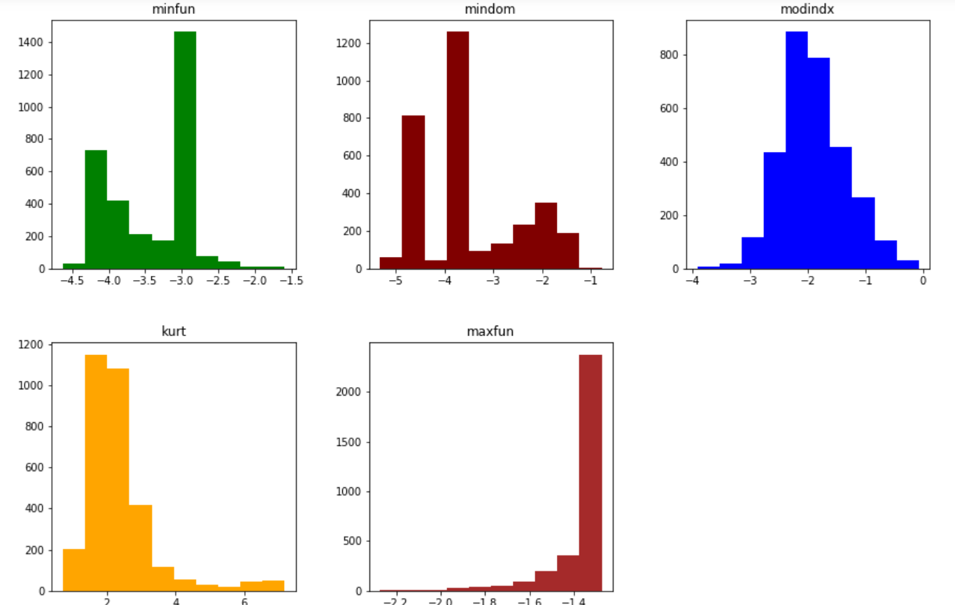
Transformation …
6. Is there a change in the skewness after it is log transformed?

Slide 13
Transformation …
6. Is there a change in the skewness after it is log transformed?
"modindx" is more or less normally distributed
Skewness is slightly better for "minfun", "mindom" and "kurt".
There is no change to "maxfun".

Slide 14
Algorithms
7. What algos / models are we going to use for predictions?
We will be using the following models
Logistic Regression
SVC
KNN
Gaussian Naive Bayes

Slide 15
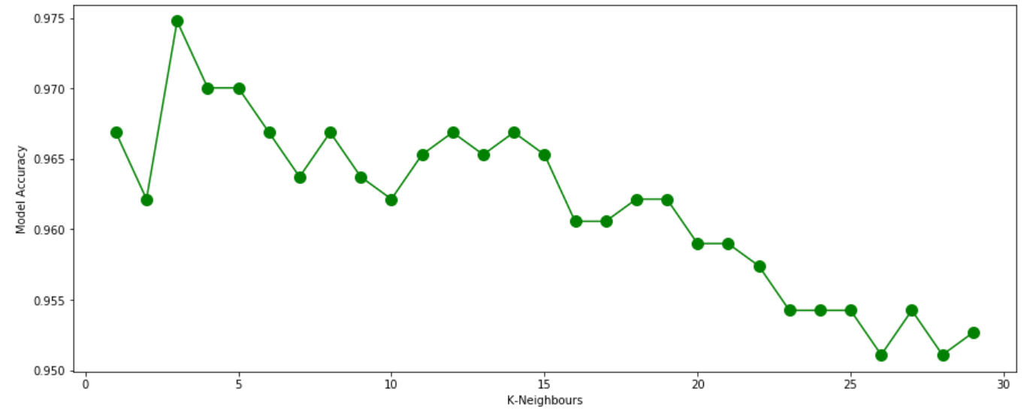
Algorithms
8. As for the KNN model, what is the optimum value of ‘K’ that provides the best accuracy score?
Best accuracy is reached when the K value is 3.

Slide 16
Algorithms
9. What is the accuracy score and prediction rate of each models?
Model | Accuracy Score | # Correct Predictions | # Incorrect Predictions
SVC | 0.9794952681388013 | 621 | 13
Logistic Regression | 0.9794952681388013 | 621 | 13
KNN | 0.9747634069400631 | 618 | 16
Gaussian Naïve Bayes | 0.9242902208201893 | 586 | 48

Slide 17
Conclusion
10. What conclusion do we arrive on the models?
SVC and Logistic Regression gives exactly the same accuracy scores, predictions and with the same wall time.
Hence in this case, can choose Logistic Regression over SVC for its explainability.

Slide 18
Thank You!!!

